Slide 1
V/AR, Brain and Learning
Amit Rozen
Alex Dan
Anat Dahan
Rotem Bennet
Nehai Farag
Darian Ryder
Nir Segal
Vered Halevi
Tal Pik
Guy Zuckerman
Boris Yazmir
Lulu Watad
Avivit Dolev
Postdocs:
Dr. Chen Ryder
Miriam Reiner
The VR and NeuroCognition lab
Technion, Israel Institute of Technology
http://vrneurocog.wixsite.com/vrneurocog
Miriamr@Technion.ac.il

Slide 2

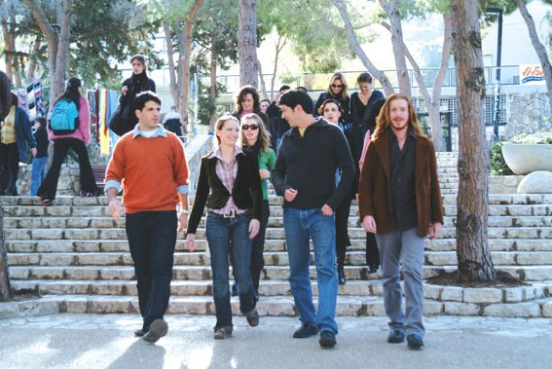


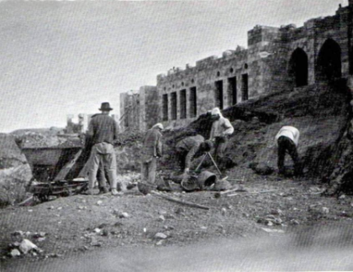


Slide 3
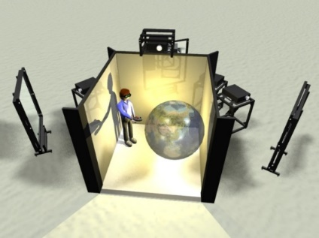
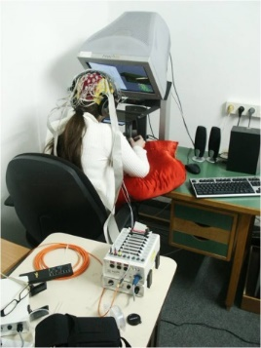

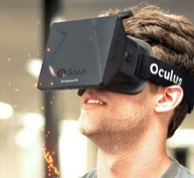
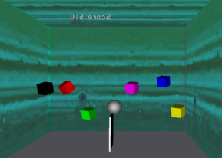
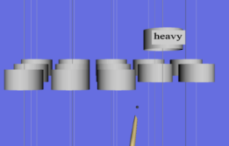
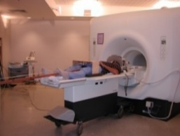
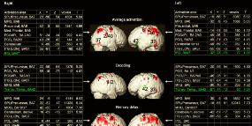
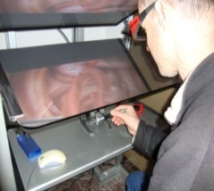
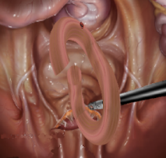
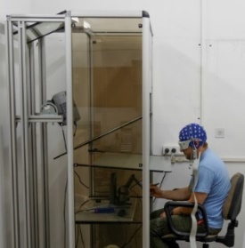
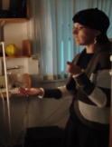
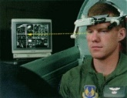
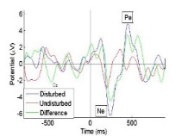

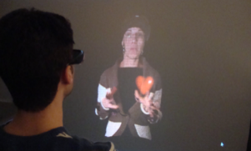
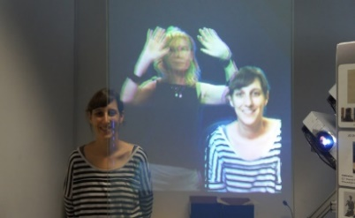
The lab: Technology and methodology
Virtual reality
Performance/learning
Virtual Reality Stimuli
EEG
EEG, eyetracking, HRV…
Participants perform a task in a highly immersive virtual reality, while connected to EEG, eyetrackers etc.
Eye
tracker
Robotic arms

Slide 4

Talk about…
V/AR – a short introduction
V/AR….the cognitive enhancement machine?
Examples --cognitive enhancement

Slide 5
Examples:
Perception:VR/AR/Flat screens? Which is advantageous?
Real-time brain measures of mental load while performing a learning task under varying conditions; (or– Is VR/AR better than flats screens?
Memory:
expedited memory consolidation and implications for a potential neural model of enhanced memory;
The shape of misconcept in science: what are neural responses when ‘you’ see the world behaving according to your own misconcepts? And how is it different from error-EEG signals?
BCI – Error signals
Implications for research and future emerging technologies for learning?

Slide 6
What is virtual reality?
Virtual Reality (VR), can be referred to as the subjective sensory experience of being immersed in a computer-mediated world

Slide 7


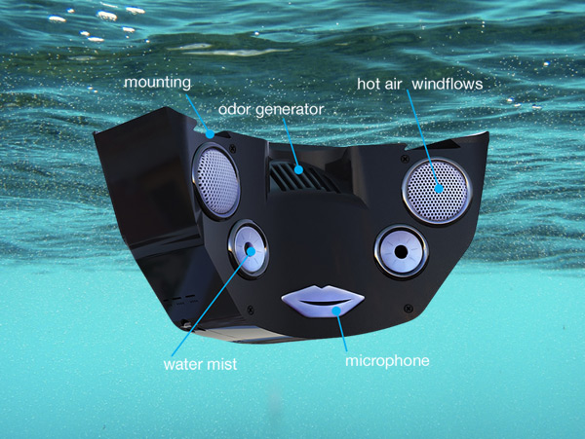
Smell, temperature, mist, sound and vision…. In VR.

Slide 8
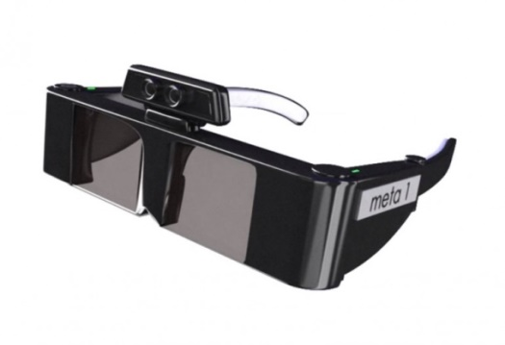


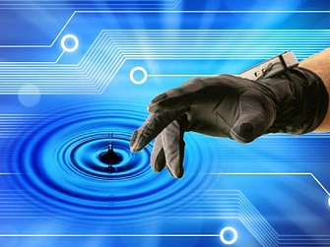
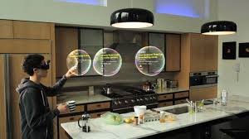
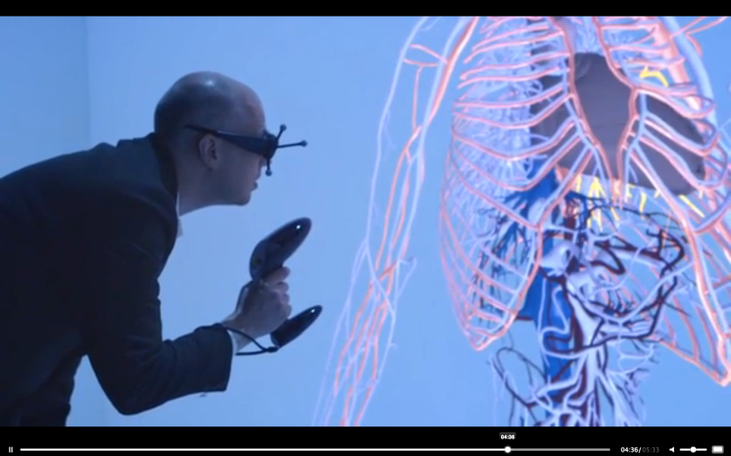
Augmented reality –virtual and physical
….special gloves, earphones, and goggles, all of which receive their input from the computer system.
.....senses are controlled by the designer. The system monitors the user's actions.

Slide 9
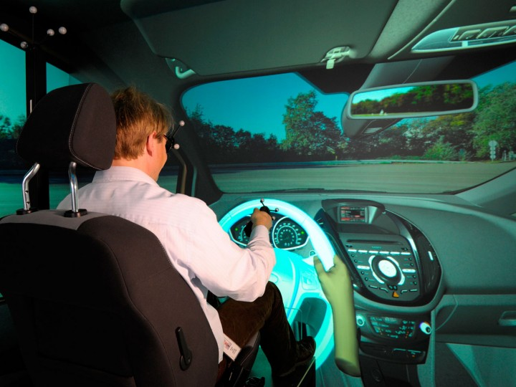
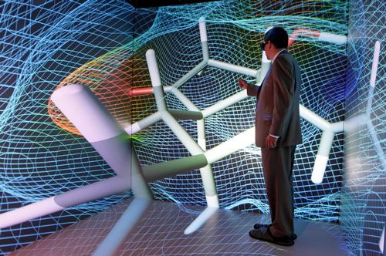
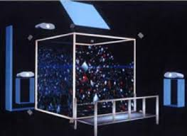
Design of the CAVE
HTC-VIVE

Slide 10
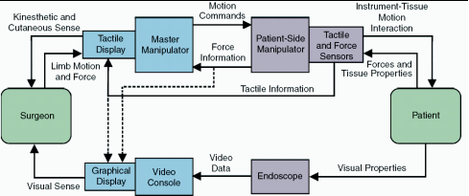
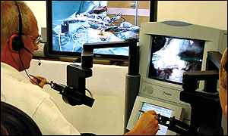
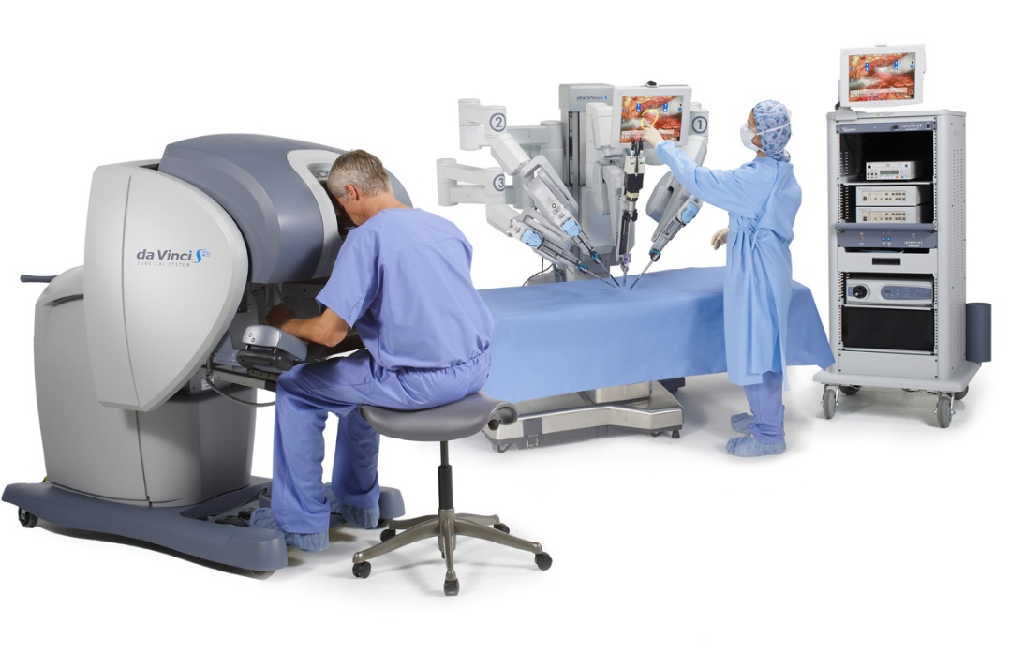
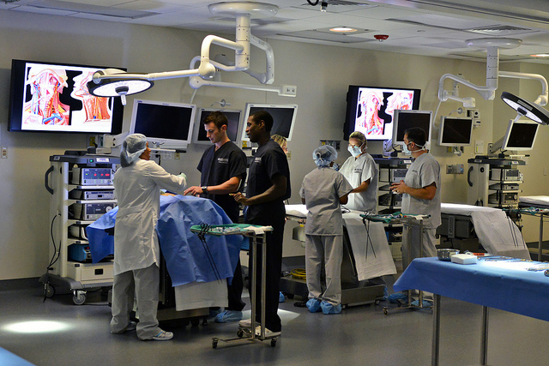
Telesurgery
https://www.youtube.com/watch?v=tAr7xjKoM5A

Slide 11

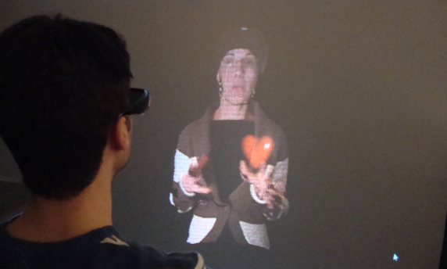
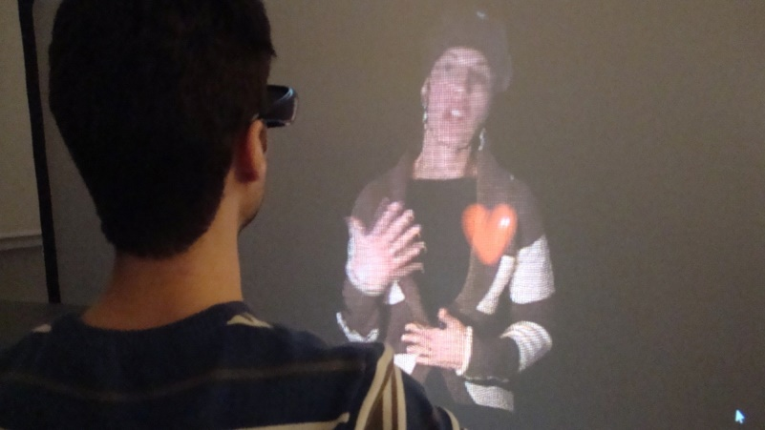
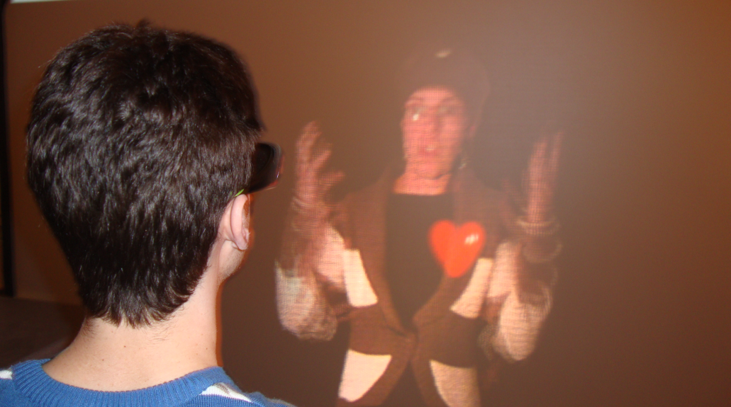
A new type of remote learning? Face-to-face like e-learning
Only about 10% is conveyed via words…
What conveys everything else?
Bodily cues, physiological changes – blush, pupil fluctuations… rhythm of voice, bodily dynamics….

Slide 12

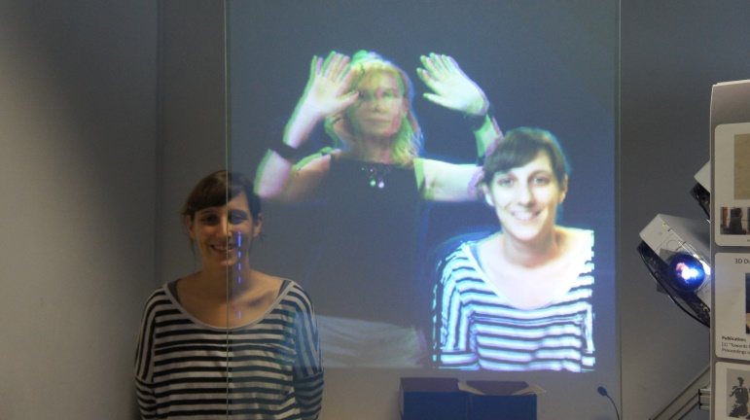
The remote teacher…. teleconferencing

Slide 13


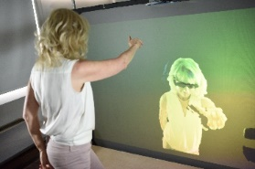
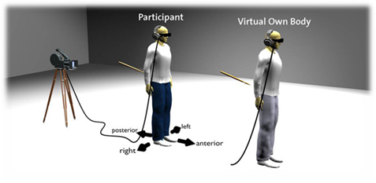
My alter body
Out-Of-Body Experience (OOBE)
Your double has freedom – it has a wider range of motion, smoother, new emotions… under the out of body experience – how will this affect your performance?
Lenggenhager, Bigna, et al. "Video ergo sum: manipulating bodily self-consciousness." Science 317.5841 (2007): 1096-1099.

Slide 14
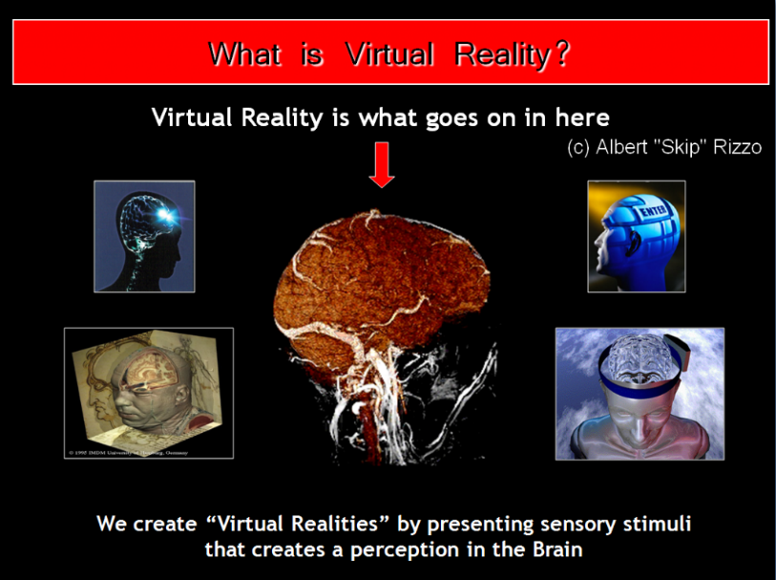
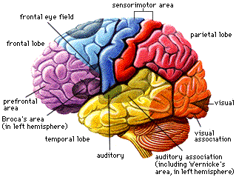
VR is a controlled tool for physiological activation of our brain

Slide 15
Claim that
If
we know what mechanisms are involved in specific cognitive functions
and
We know how to stimulate these mechanisms
then:
We can implant sensory stimuli into a virtual world that will activate the relevant brain areas for enhance performance.

Slide 16
V/AR: the machinery cognitive enhancement?
In creating a Virtual world we design sensory experiences. orchestrate sensory stimuli to create virtual taste, sight, smell, sound, and touch.
Sensory perception and manipulation are the tools for higher reasoning skills (Pappert ‘Minstorms’ …
Can we use VR in the context of ealeraning for Cognitive enhan cement?

Slide 17
Three examples
VR/AR vs flat screens – which is superior from a perceptual processing point of view?
Enhanced spatial intelligence with VR –neurofeedback, enhanced memory consolidation
Errors signals, Brain Computer Interfaces

Slide 18
Example 1:
Perception:
2D vs 3D VR
EEG measures of mental load during problem solving in 2D and 3D VR.
PhD of Alex Dan

Slide 19
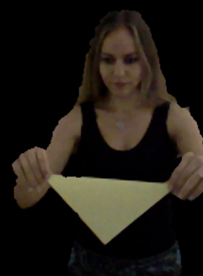
Method
Two groups.
observed a remote instructor demonstrating two origami tasks – simple/complex- in 2D flat display Then in VR 3D.
The second group followed the same procedure, in reversed order
EEG was measured in real time.
Participants were asked to repeat the folding for the demonstrated easy/difficult task. EEG was not taken during folding

Slide 20

Procedure
The Cognitive load index was calculated based on the Theta Fz/Alpha Pz ratio (Holm et al., 2009). For each participant, Alpha Pz, Theta Fz, and the average cognitive load index for the observation sessions was assessed.
$${CLI}_{n}= \frac{{Theta }_{Fz n}}{{Alpha }_{Pz n}}$$
EEG File
select learning interval, epochs
Artifacts reduction
ICA and Analysis
Set Fourier analysis and parametrers
Lenght of epoch
Analyze
Polynomial trends paremetres
Haning time window
Table ouput of EEG spectra, amplitude and average frequency

Slide 21
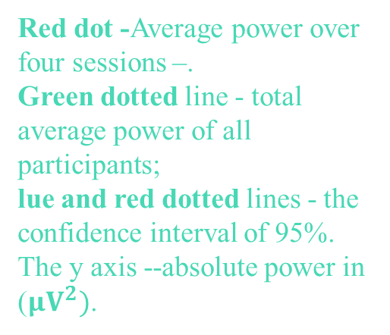
Results
A significantly larger CLI in 2D compared to 3D
for both tasks for all participants
(matched pairs t-test, N = 17, t-ratio = -3.0681, SDE = 0.09483, p < 0.0037**).
Task+display | Box 2D | Box 3D | p-value
CLI (SDE) | 0.8385 (0.024) | 0.4596 (0.096) | < 0.0001*
Task+display | Crane 2D | Crane 3D | p-value
CLI (SDE) | 1.2483 (0.128) | 0.500 (0.094) | < 0.0002**
p-value | p < 0.0292* | = 0.8
Red dot -Average power over four sessions –.
Green dotted line - total average power of all participants;
lue and red dotted lines - the confidence interval of 95%. The y axis --absolute power in ($μV^{2})$.

Slide 22
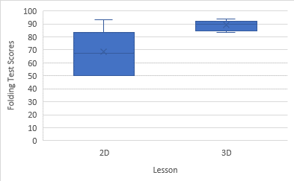
Performance –folding scores
Folding Test scores of participants (N=14) after observing and performing 2D/3D instructions of folding. The y-axis represents Folding Test scores. The x-axis represents the groups.. The bars represent the SDE. The box represents the distribution of participants

Slide 23
Meaning what…?
Higher mental load is correlated with higher ambiguity – 2D is more ambiguous than 3D?
Higher Mu rhythms in the 3D condition compared to 2D.
Higher mental load is associated with a larger number of items during ‘short-term-memory’. Need to remember more in 2D? 3D supports memory by reducing the number of items to be memorized?

Slide 24
Example 2
Expedited memory consolidation – theta effects

Slide 25
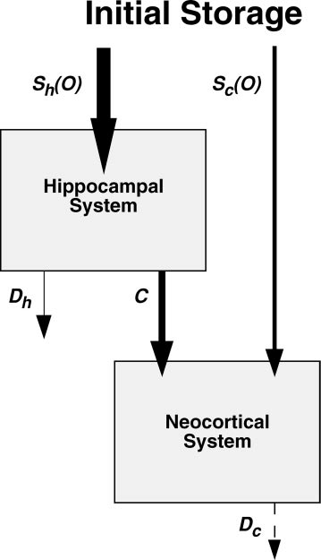
Enhanced memory consolidation-?
A two stage memory consolidation process
The hippocampal system and the neocortical system. Sh(0) and Sc(0) represent the strength of the initial hippocampal and neocortical traces, respectively
The hippocampal representation later becomes active on sleep (and recall).
Creates a neocortical trace, ….consolidation.
Theta oscillations occur during the hippocampus-neocortex interaction
In parallel memory decays much faster in the hippocampus (Dh) than in the cortex (Dc).
With Roman Rozengurt and Dr. Anat Barnea

Slide 26
We ask:
What is the effect of enhanced theta on memory consolidation of a motor sequence task, during awake hours?

Slide 27
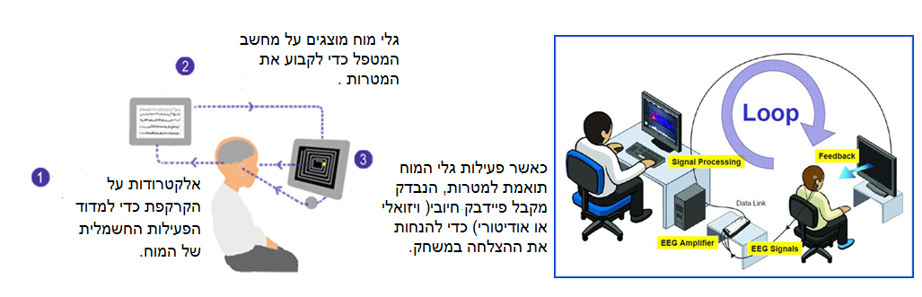
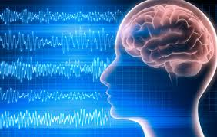
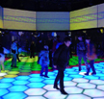
We ask:
…..whether memory consolidation can be enhanced during awake hours?
Use a game VR +Neurofeedback – enhanced in VR

Slide 28
Grouping and treatment
Table 1: Grouping and treatment
Group | Treatment
Experimental- theta NFT | 27 minutes of theta NFT
Control beta NFT | 27 minutes of beta NFT
Control | 27 minutes of watching movies

Slide 29
EEG-neurofeedback
NFT (neuro feedback training): Each participant went through one session of NFT Each session consisted of nine rounds of 3 minutes each, a total of 30 minutes. EEG was recorded and the relevant frequency components were extracted.
Participants were asked to accelerate the car/robot ‘by thought’. The feedback was provided when specific conditions (theta up or beta up) were satisfied for a minimum of 3 seconds. An auditory beep and a visual display of the speed of a car in a game like environment were presented on the screen for reinforcement.

Slide 30
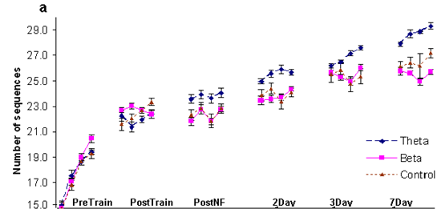
Effect of NFT and sleep
Performance in each group. Each point represents averaged number of sequences completed in 30 seconds. Four connected points represent the four blocks of one test
Reiner, M., Rozengurt, R., & Barnea, A. (2014). Better than sleep: Theta neurofeedback training accelerates memory consolidation. Biological psychology, 95, 45-53.
http://www.bbc.com/future/story/20140721-how-to-learn
Notes:
One-way ANOVA analysis was performed to reveal possible differences between the groups in the first test, the second test and in the rate of change from the first to the second test. As expected, there were no differences between the groups in the first test [F(2, 31)=0.05, n.s], the second test [F(3,21)=0.1; n.s.] and no difference in the rate of change from the first to second test. [F(3,21)=0.5; n.s].

Slide 31
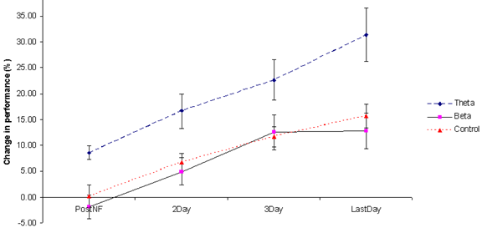
Performance after NFT
Differences in performance before and after, with/out neurofeedback training. Differences in performance are measured as the ratio of performance at each specific test and the baseline (the T1 test).

Slide 32
Results- overall improvement baseline and day 7
The overall improvement in performance, between the baseline (after training) until the 7th day, was significant [F(2,31)=4.9; p<0.01],
theta group [M=21.9; SEM=3.9] improving more than beta (M=12.6; SEM=1.95) [p<0.01] and control groups (M=12; SEM=1.8) [p<0.01].
difference between beta and control groups was not significant.
a week after training and NF: As in the previous tests, there was an improvement in the theta group by an additional 8.5% (1.8 delayed gains). only small non-significant improvements in beta and control groups: beta 0.%, control, 4% .
all subjects from the theta group showed improvement in the last test. only 5/14 in the beta group improved in the last test. In the control group, all participants improved with very small gains.

Slide 33
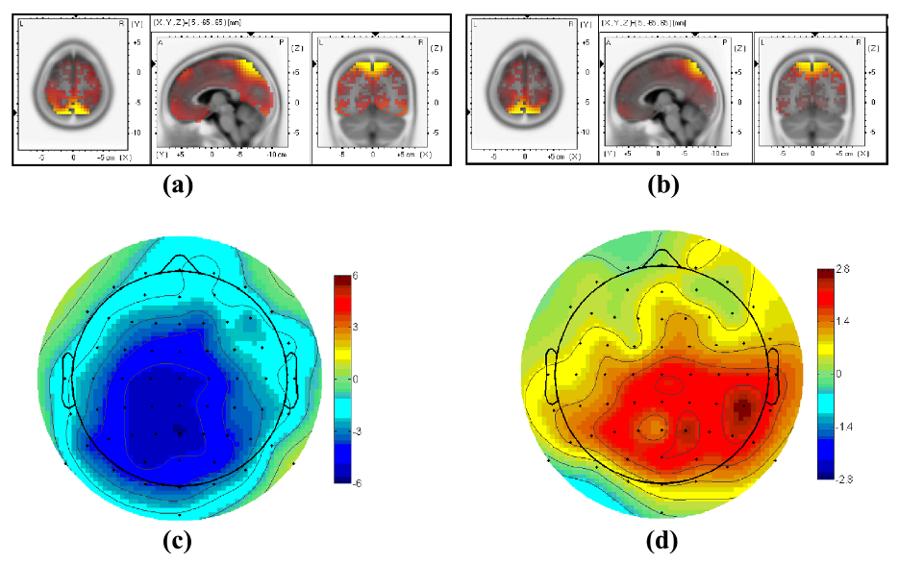
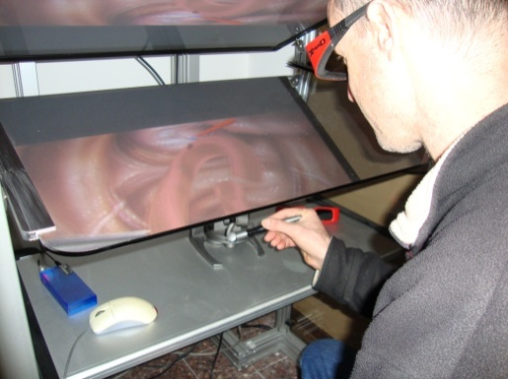
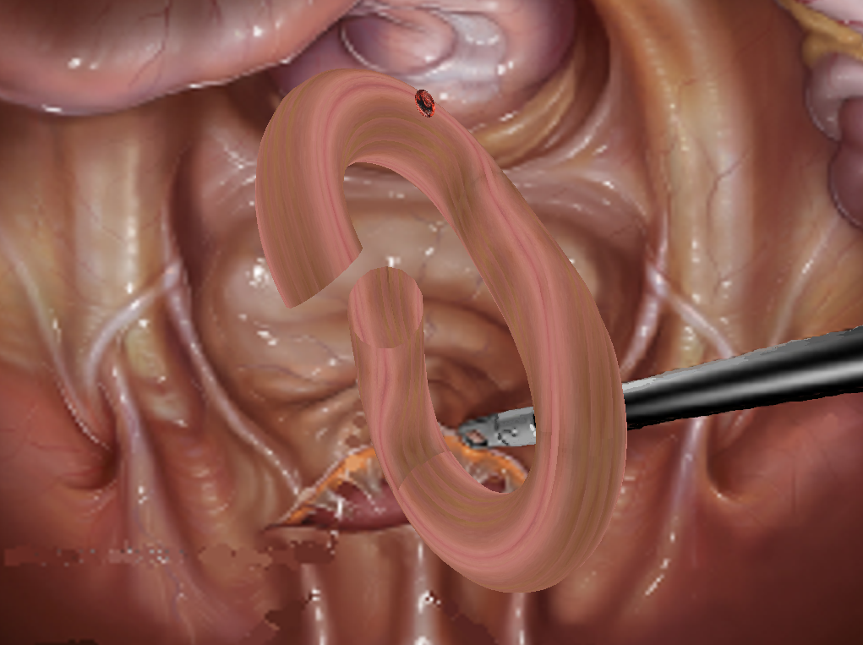
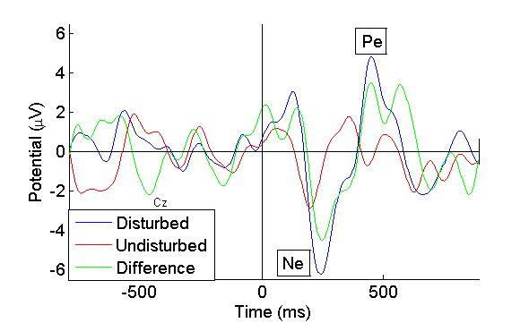

A tailored error-response, BCI Classifier?
An EEG -- error potential occurs, even before execution of the error
A
E
D
C
F
B
A

Slide 34





Examples Memory and errors: The implicit – explicit gap in perception : misconcepts in physics –what are neural responses when ‘you’ see the world behaving according to your own misconcepts?
Results
All caught correctly
The conceptual Stroop effect: incongruency leads to a longer response time compared to congruent cues.
Participants saw a falling pendulum in a virtual world. 120 events. Randomly separated between correct/incorrect according to participants self reported physics concept/misconcepts.
Measures:
Time to catch
Did they catch – yes/no
EEG mainly P3 responses.

Slide 35
Visual Overview
VR enhances performance by reducing mental load
A game to provide feedback for controlling self brain oscillations for enhanced memory consolidation
The illusion of students misconcepts
The implicit explicit gap

Slide 36











http://vrneurocog.wix.com/vrneurocog
Thanks!!
Acknowledgments
Mental
rotation
The role of the mirror neuron system
in recognition of gestures
Shaping perception
In Virtual worlds;
EEG index
of mental load
A intelligent
Emotional 3D
digital teacher
Games in VR and
spatial skills in geometry
Lab engineer
ADHD – enhancement
in VR?
Subliminal cues EEG markers
of insight in problem solving
Memory consolidation
In math
EEG measures
of naïve physics
Errors in learning

Slide 37


Event related emotional responses?
How do we relate emotions to events?
Emotional Responses to Events on a video…

Slide 38
Watching events on a video, screen (e.g. news) How does the raw emotional data look like?

Slide 39

Event related emotions

Slide 40
By applying the stress theory, we identified four emotional levels:
Barely engaged, bored, engaged in other events
Calm somewhat interested. ‘Willing to listen’,
Highly involved, interested
Stressed
Emotions X Events:
1-tax. problem
2. candidate as a citizen
3 - Supreme Court
4 -clean energy, job opportunity

Slide 41
- stress
- interest
- calm
- weak
 | Q4 | Q3 | Q2 | Q1
Subject 1 |  |  |  |  | Clinton
Subject 2 |  |  |  |  | Clinton
Subject 1 |  |  |  |  | Trump
Subject 2 |  |  |  |  | Trump

Slide 42


Evolution of stress….what makes one stressed…?
https://youtu.be/B3OjfK0t1XM
Projects: embedded computing for knowing and controlling self stress….;
Designing the environment for reduced stress; stress as predictors of depression; multisensory VR for reduction of stress, without chemistry;

